Slide 1
Typical case
2-person game
Players alternate moves
Zero-sum: one player’s loss is the other’s gain
Perfect information: both players have access to complete information about the state of the game. No information is hidden from either player.
No chance (e.g., using dice) involved
Examples: Tic-Tac-Toe, Checkers, Chess, Nim

Slide 2
How to play a game
A way to play such a game is to:
  Consider all the legal moves you can make
  Compute the new position resulting from each move
  Evaluate each resulting position and determine which is best
  Make that move
  Wait for your opponent to move and repeat
Key problems are:
  Representing the “board”
  Generating all legal next boards
  Evaluating a position

Slide 3
Evaluation function
Evaluation function or static evaluator is used to evaluate the “goodness” of a game position.
  Contrast with heuristic search where the evaluation function was a non-negative estimate of the cost from the start node to a goal and passing through the given node
The zero-sum assumption allows us to use a single evaluation function to describe the goodness of a board with respect to both players.
  f(n) >> 0: position n good for me and bad for you
  f(n) << 0: position n bad for me and good for you
  f(n) near 0: position n is a neutral position
  f(n) = +infinity: win for me
  f(n) = -infinity: win for you

Slide 4
Evaluation function examples
Example of an evaluation function for Tic-Tac-Toe:
  f(n) = [# of 3-lengths open for me] - [# of 3-lengths open for you]
  where a 3-length is a complete row, column, or diagonal
Alan Turing’s function for chess
  f(n) = w(n)/b(n) where w(n) = sum of the point value of white’s pieces and b(n) = sum of black’s
Most evaluation functions are specified as a weighted sum of position features:
  f(n) = w₁*feat₁(n) + w₂*feat₂(n) + ... + w_{n}*feat_{k}(n)
Example features for chess are piece count, piece placement, squares controlled, etc.
Deep Blue has about 6000 features in its evaluation function

Slide 5
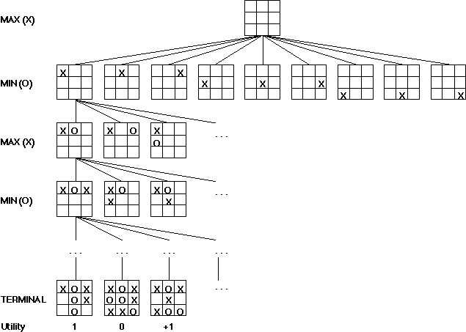
Game trees
Problem spaces for typical games are represented as trees
Root node represents the current
board configuration; player must decide the best single move to make next
Static evaluator function rates a board position. f(board) = real number with
f>0 “white” (me), f<0 for black (you)
Arcs represent the possible legal moves for a player
If it is my turn to move, then the root is labeled a "MAX" node; otherwise it is labeled a "MIN" node, indicating my opponent's turn.
Each level of the tree has nodes that are all MAX or all MIN; nodes at level i are of the opposite kind from those at level i+1

Slide 6
Minimax procedure
Create start node as a MAX node with current board configuration
Expand nodes down to some depth (a.k.a. ply) of lookahead in the game
Apply the evaluation function at each of the leaf nodes
“Back up” values for each of the non-leaf nodes until a value is computed for the root node
  At MIN nodes, the backed-up value is the minimum of the values associated with its children.
  At MAX nodes, the backed up value is the maximum of the values associated with its children.
Pick the operator associated with the child node whose backed-up value determined the value at the root

Slide 7
Minimax Algorithm
2
2
1
2
1
2
7
1
8
2
7
1
8
2
7
1
8
This is the move
selected by minimax
2
Static evaluator
value
2
1
MAX
MIN
2
7
1
8

Slide 8
Partial Game Tree for Tic-Tac-Toe
f(n) = +1 if the position is a win for X.
f(n) = -1 if the position is a win for O.
f(n) = 0 if the position is a draw.

Slide 9
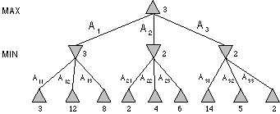
Minimax Tree
MAX node
MIN node
value computed
by minimax
f value

Slide 10
Alpha-beta pruning
We can improve on the performance of the minimax algorithm through alpha-beta pruning
Basic idea: “If you have an idea that is surely bad, don't take the time to see how truly awful it is.” -- Pat Winston
MAX
>=2
We don’t need to compute the value at this node.
No matter what it is, it can’t affect the value of the root node.
MIN
=2
<=1
MAX
2
7
1
?

Slide 11
Alpha-beta pruning
Traverse the search tree in depth-first order
At each MAX node n, alpha(n) = maximum value found so far
At each MIN node n, beta(n) = minimum value found so far
  Note: The alpha values start at -infinity and only increase, while beta values start at +infinity and only decrease.
Beta cutoff: Given a MAX node n, cut off the search below n (i.e., don’t generate or examine any more of n’s children) if alpha(n) >= beta(i) for some MIN node ancestor i of n.
Alpha cutoff: stop searching below MIN node n if beta(n) <= alpha(i) for some MAX node ancestor i of n.

Slide 12
Alpha-beta example
MAX
3
MIN
3
2 - PRUNE
14
5
2
3
12
8
2
14
5
2

Slide 13
Alpha-beta algorithm
function MAX-VALUE (state, game, alpha, beta)
;; alpha = best MAX so far; beta = best MIN
if CUTOFF-TEST (state) then return EVAL (state)
for each s in SUCCESSORS (state) do
alpha := MAX (alpha, MIN-VALUE (state, game,
alpha, beta))
if alpha >= beta then return beta
end
return alpha
function MIN-VALUE (state, game, alpha, beta)
if CUTOFF-TEST (state) then return EVAL (state)
for each s in SUCCESSORS (state) do
beta := MIN (beta, MAX-VALUE (s, game, alpha, beta))
if beta <= alpha then return alpha
end
return beta

Slide 14
Effectiveness of alpha-beta
Alpha-beta is guaranteed to compute the same value for the root node as computed by minimax, with less or equal computation
Worst case: no pruning, examining b^d leaf nodes, where each node has b children and a d-ply search is performed
Best case: examine only (2b)^(d/2) leaf nodes.
  Result is you can search twice as deep as minimax!
Best case is when each player’s best move is the first alternative generated
In Deep Blue, they found empirically that alpha-beta pruning meant that the average branching factor at each node was about 6 instead of about 35!

